Slide 1

Notes:
Hello, everyone. We are the Stalky team and we are here to present our amazing idea to you. So let’s get to it right away.
Now, I don’t know about you, but me, I’m terrible with names.

Slide 2

The Team
The Team

Slide 3
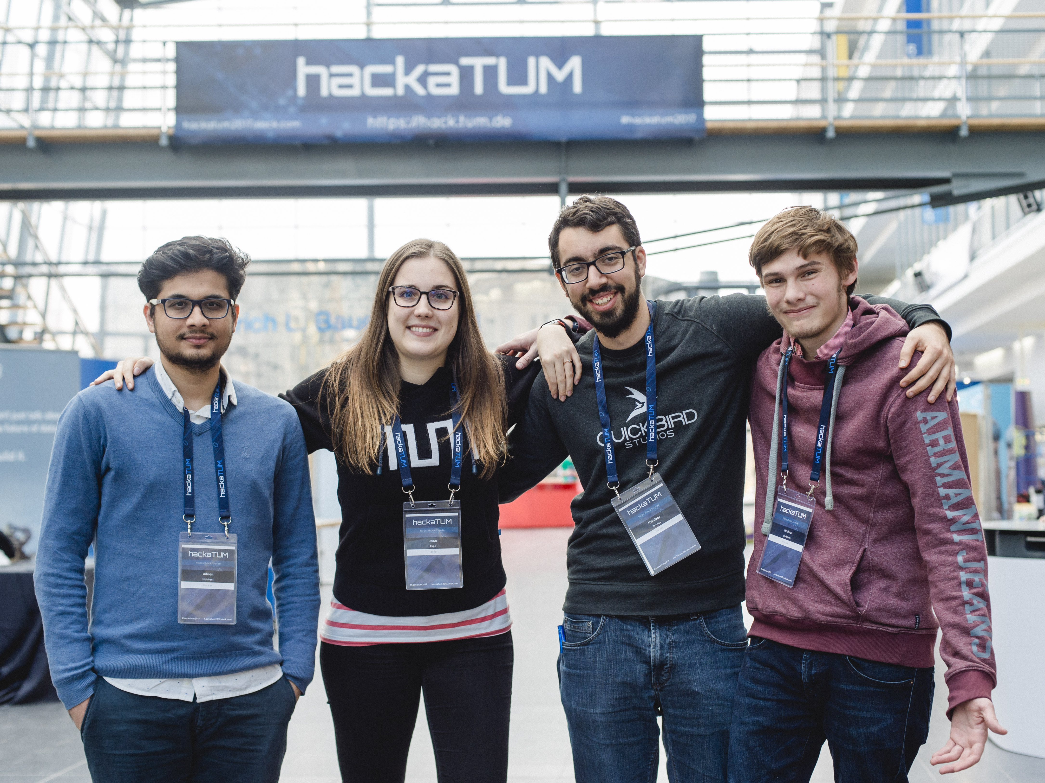
Niko Tzioras
Mathias Quintero
Adnan Makhani
Jana Pejić
Student @ TUM
Student @ TUM
Student @ TUM
Developer
Big “Person of Interest” Fan
Spezi Enthusiast
Loves to Travel
Long Time Mentor

Slide 4

Motivation

Slide 5

Impress Ray by remembering his name
Notes:
Recently someone approached me in the street, started talking to me about exams and all I could think about was: “what is this person’s name?!” And boy did I wish I had Stalky that day.

Slide 6

Always find the perfect topic
Notes:
Or has it ever happened to you to meet an old friend in the metro and just not know what to talk about? For these and many more situations we invented Stalky.

Slide 7

How it Works

Slide 8




Stalky
Augmented Reality
Have your information
when and where
you need it
Artificial Intelligence
Let technology
fill in the gaps
Personal Social Assistant
Get all the
important hints
Notes:
For these and many more situations we invented Stalky. We combined AR and the power of computer vision to create the perfect personal social assistant. Stalky helps you remember people that you come across in your daily life and tells you all the little details you need to know about them.

Slide 9




Architecture
Notes:
We connect to social media to gather interests and photos of a user and we feed that data to the Microsoft Azure Cloud Platform. Utilising its powerful Face API we match the person in front of us to a name and other information they shared with us.
This scenario fits seamlessly into the smart glasses experience. However technology still hasn’t quite caught up with our vision. That’s why in the last two days we developed a smartphone app.

Slide 10

Demo Video

Slide 11


Slide 12

Check out more
https://devpost.com/software/stalky
https://github.com/mathiasquintero/stalky-app
https://github.com/greece57/stalky_backend

